Slide 1
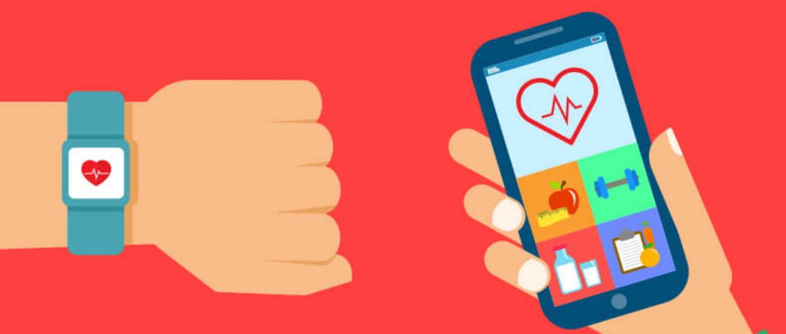
HMI 7540 Healthcare Info Systems Development
Pediatric Asthma Management Tool
Joli Miracle
Jasmine Williams
Bryana Higginbotham

Slide 2
Introduction: Mobile Health (Mhealth)
considered unruly technology
has become a module of many consumers informatics, disease management and telemedicine strategies
Mhealth is a subcategory of ehealth (electronic health), which can be defined as the “delivery of healthcare services via mobile communication devices”

Slide 3
Mobile Applications and Wearable Devices
Wearable health IT is used to measure, track, and trend various health parameters
Fastest growing health trend witithin the last 10 years with a variety of new devices and sensors
Monitoring exercise, sleep, heart rate and variability, respiratory rate, hydration, etc. and considered part of the mobile technology armamentarium.
Supporting Information:

Slide 4

Project Description
The program will prompt users to answer a short questionnaire when/if a child is exhibiting symptoms and based on their responses the directions for the recommended treatment plan will populate to prompt their prescribed optimal course of management. The output will return the recommended treatment option, such as their prescribed “as needed” medication management or based on severity or length of symptoms would notify the patient to contact their provider or seek immediate medical care. The software would function to provide timely clarification of when pediatric patients should initiate their "as needed" treatment.

Slide 5
Proper Management Plans
What is asthma, Why this topic?
Mhealth affordable and highly accessible
Easy to manage
Long term and resourceful

Slide 6
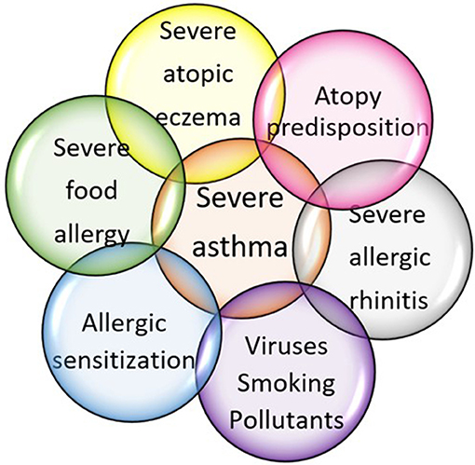
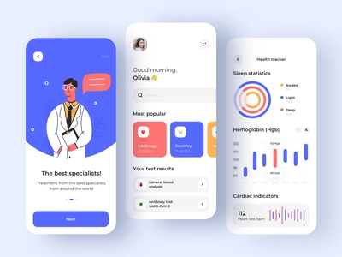

Slide 7

Project Goal
bridge the gap in “as needed” asthma treatment management for children
alleviate the stress over questioning “when to do what” and “how to do it”
better track how someone’s asthma has been managed
allow providers to see what symptoms and treatments a patient has experienced between physical visits
assist providers in adjusting future treatment plans

